Slide 1

Iron Man Team 2
How do we interact with music?

Slide 2

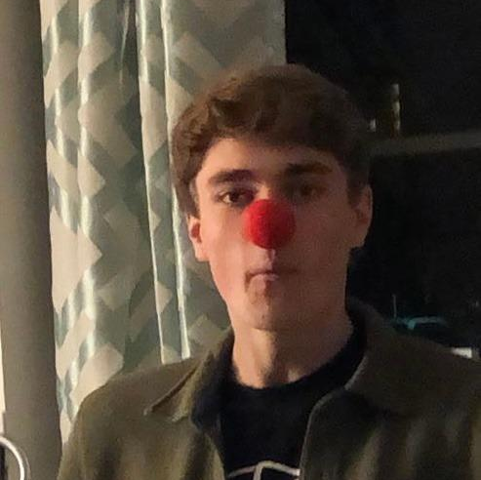

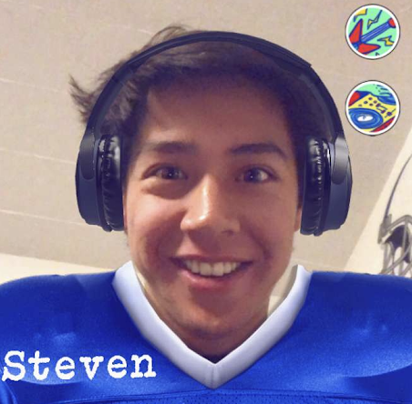
Our Team
Sebastian
Connor
Corbin
Steven
Notes:
Our Team

Slide 3
Exploring Domains
Social
Consumption
Discovery
Music
Medium
Learning
Interests
Collaboration
Sports
Practice Habits

Slide 4
Participant Selection
Relevant Age Group
Different level of musical ability
Diversity of Listening habits
Not limited to Stanford
*Need to improve age diversity, education diversity, and reduce familiarity

Slide 5
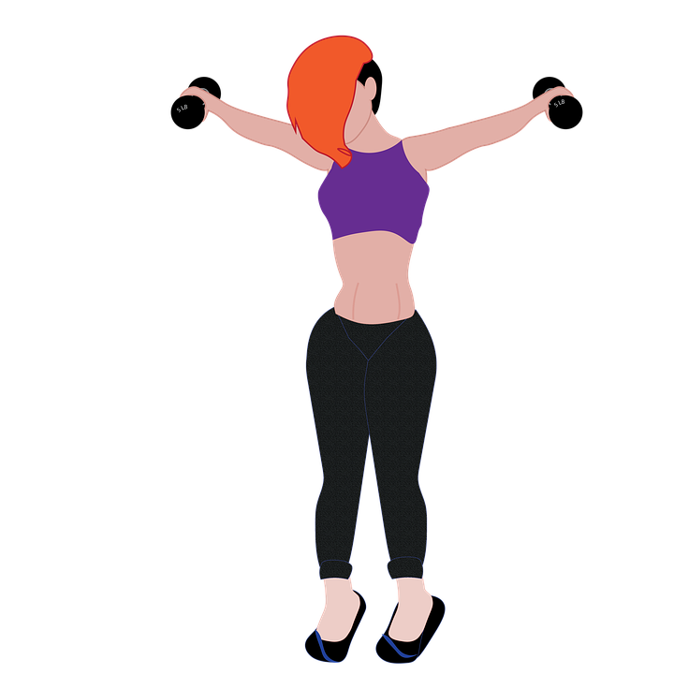

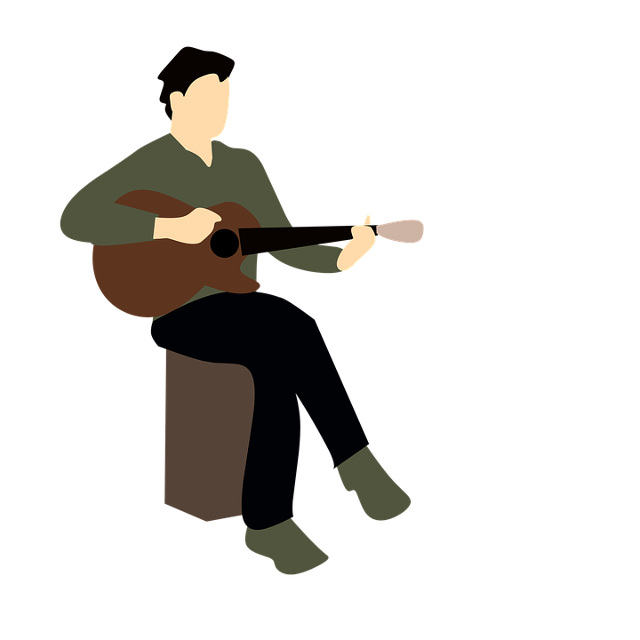
Our Participants
Gus
Emily
Sauren
Avid Creator and Consumer
Playlist Enthusiast Music + Exercise
Drummer and Metalhead
Notes:
Our Team

Slide 6
findings

Slide 7


Methodology
Restricted by ongoing pandemic
Mix of zoom and in person interviews
Baseline questions, but focus on flow
Let the subject lead the conversation
Found subjects through personal connections

Slide 8
Guiding Questions
How do you consume music?
How do you socialize musically?
How much do you listen?
How do you discover new music?
Do you play an instrument?
What affects your listening habits?

Slide 9

Emily
“I like going to the gym and finding playlists to set me in the mood–like ‘hype gym’ or ‘power workout’. I like to find a certain type of music to play that fits the vibes when I’m on aux.”
Emily
College junior, Playlist Enthusiast

Slide 10

Gus
“I started learning guitar recently using an app to learn. It seemed good for someone that has never played an instrument, but there is no option to speed up the pace.”
Gus
College senior, avid creator and consumer of music

Slide 11
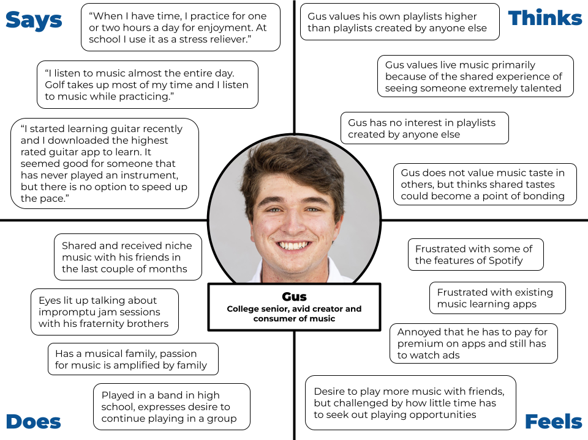

Slide 12
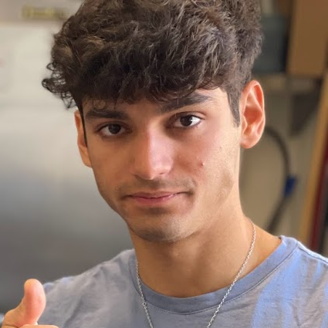
Sauren
“I’ve been getting into ‘slowed + reverb’ music of popular songs when I study, which is on YouTube, not Spotify.”
Sauren
Masters student, metalhead, drummer, 8hrs of music per day

Slide 13
POV
We met
We were amazed to realize
It would be game changing to
Gus, a musical creator
He didn’t have control over his learning experience
Put learning in the hands of the musician with adaptive assistance
Emily, a playlist connoisseur
She seeks playlists made by strangers
Connect people to playlists of other users in a social way
His music taste swings dramatically when he is alone
Help listeners seamlessly cater listening to their environment
Sauren, a Metalhead

Slide 14
Summary
We learned that there is a diverse set of musical needs across different people
We asked how people interact with music in their daily lives
We found that control is an important part of any music experience
Personalizing how to engage with and seek music was a common idea
To some, a lack of control is important. To others, more control is desirable
Listeners and creators all want control over their music

Slide 15
Next Steps…
Pinpoint Generative Conclusions from Interviews
Supplement with additional, more targeted interviews
Select broader base of interviewees
Prototyping + HMW statements
Attack specific pillar of interest

Slide 16
Thank You!!

